Slide 1
The Early-Stage Impacts of COVID-19 on Small Business Owners and Related Research:
Bradford-Osborne Research Award
Robert Fairlie
University of California, Santa Cruz and NBER
Foster School of Business, University of Washington
April 29, 2022

Slide 2
The Early Impacts of COVID-19
Stores, factories and many other businesses closed by policy mandate, downward demand shifts, health concerns, or other factors.
But the early effects of COVID-19 on small businesses were difficult to measure because of the lack of timely data, especially by race, ethnicity and gender
How large were the early-stage impacts of COVID-19 and were there disproportionate impacts for specific demographic groups?
Use Current Population Survey (CPS) microdata from the Bureau of Labor Statistics (BLS) to track active business owners in the pandemic

Slide 3
Timeline
March 11, 2020: The World Health Organization (WHO) declared COVID-19 a pandemic.
March 16, 2020: San Francisco Bay Area imposed shelter-in-place restrictions
March 19, 2020: State of California
March 20, 2020: New York State
By early April: most states imposed social distancing restrictions

Slide 4
April 2020

Slide 9
Industry Changes

Slide 11
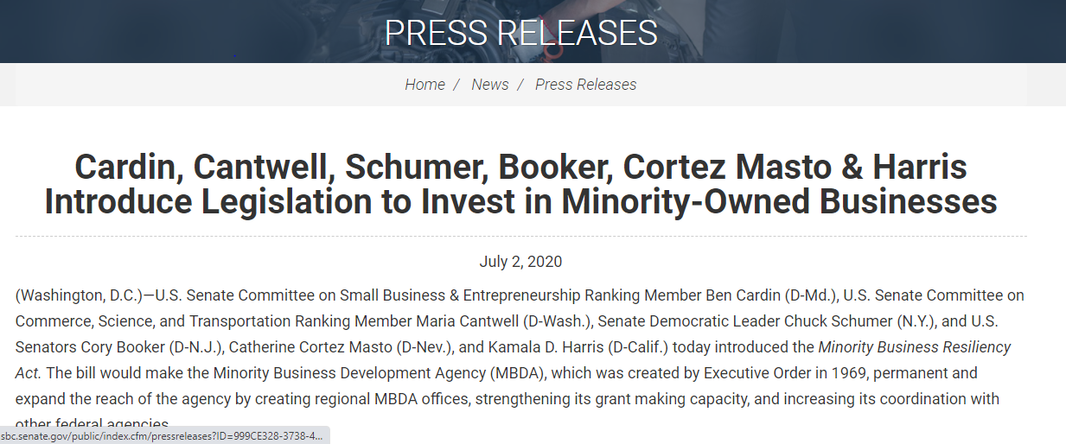
“The COVID-19 pandemic has shed light to the disparities already facing minority-owned small businesses,” said Harris. “With over 40% of Black small businesses closed due to COVID-19, its imperative Congress ensure that we are doing everything we can to support and lift up these businesses, particularly during a health and economic pandemic.

Slide 12
Has There been a Rebound in Small Business Activity since April 2020?
Ongoing tracking of business ownership patterns based on requests by:
President’s Office
Vice President’s Office
Senate and House Testimonies and Committees
California State Assembly and Governor’s Office
Media

Slide 13
October 2020
December 2021
February 2021
April 2020

Slide 16
Follow-up Research Projects
What happened to other small business outcomes in the pandemic?
  Permanent business closures
  Did new businesses arise out of necessity from job losses?
  What happened to business owner earnings?
Paycheck Protection Program
  Were funds allocated proportionately to communities of color?
  Evolution of program over time?
  U.S. Senate

Slide 17
Permanent Small Business Closures
CPS: active business owners (temporary or permanent closures?)
Surprisingly little is known on whether these shutdowns turned into permanent closures and whether small businesses were disproportionately hit.
Difficult to measure permanent closures
Create and analyze measure of permanent business closures using confidential administrative firm-level panel microdata
Covers the universe of businesses filing sales taxes
California Department of Tax and Fee Administration

Slide 21
What happened to small business owners in the pandemic?
Did new businesses arise out of necessity from job losses?
  Kauffman Early-Stage Entrepreneurship Indicators
  Opportunity Share
What happened to business owner earnings?
  ASEC (March) CPS Files include calendar year earnings (2020)
  Project for the Small Business Administration

Slide 24
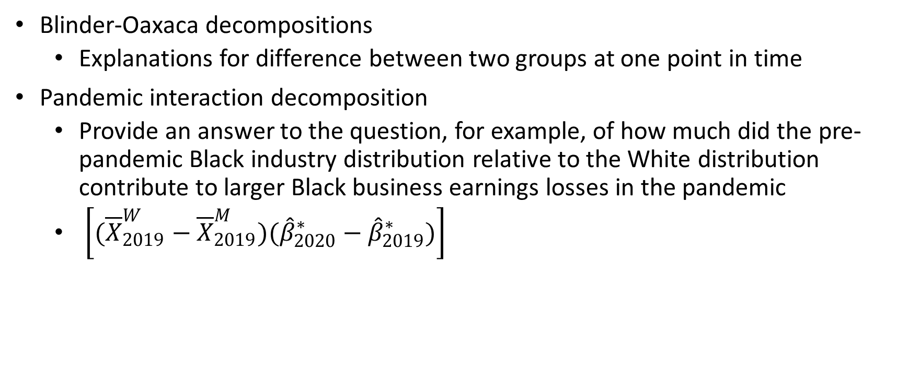
Pandemic What happened to small business owners in the pandemic?
Blinder-Oaxaca decompositions
  Explanations for difference between two groups at one point in time
Pandemic interaction decomposition
  Provide an answer to the question, for example, of how much did the pre-pandemic Black industry distribution relative to the White distribution contribute to larger Black business earnings losses in the pandemic
  $\left[({\overline{X}}_{2019}^{W}−{\overline{X}}_{2019}^{M})({\hat{β}}_{2020}^{∗}−{\hat{β}}_{2019}^{∗})\right]$

Slide 26
Paycheck Protection Program
Provided loans to small businesses that could be forgiven if employees were kept on the payroll through the pandemic
Were funds allocated proportionately to communities of color?
Evolution of program over time?
Size and scope of program:
  Number of loans=11,823,594
  Total net dollars=$799,832,866,520
  Number of different lenders=5,467

Slide 27
Paycheck Protection Program Loans per Employer Establishment by Minority Share of Zip Code
First Round (April 3-April 16, 2020)

Slide 28
Paycheck Protection Program Loans per Employer Establishment by Minority Share of Zip Code
First Round (April 3-April 16, 2020)
Second Round (April 27-August 8, 2020).

Slide 29
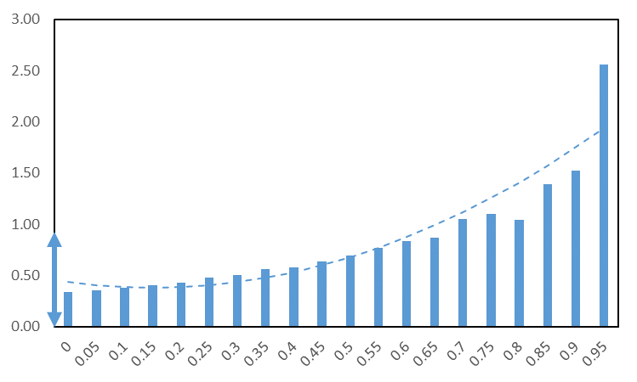
Paycheck Protection Program Loans per Employer Establishment by Minority Share of Zip Code
Third Round (2021)

Slide 30
Summary
Business owners of color were disproportionately affected early in the pandemic
  But, strong rebound from early losses
Other outcomes were affected: many permanent closures, necessity entrepreneurship increased, and business owner earnings fell
PPP funds were slow in being distributed to minority communities
  But, 2021 (third round) aggressively targeted small businesses in those communities
More research needed on long-term effects on inequality and PPP effectiveness

Slide 31
More Information
Research
https://people.ucsc.edu/~rfairlie/papers/
Small Business Tracking
https://people.ucsc.edu/~rfairlie/recent/
Government Testimony and Bills
https://people.ucsc.edu/~rfairlie/government/

